Slide 1

Chalcones
Naringenin chalcone
Flavonoid pathway begins with production
of coumaric acid and addition of malonate
to form naringenin chalcone
A few metabolic steps from naringenin
chalcone yield a variety of products
1
3
Butein
2
Butea monosperma
The spectacular orange color of some flowers is due to the production of the chalcone pigment butein
1,2: LFP 3: www.flickr.com/photos/santoshnc/2365615498/ (Photo by S. N. Chandran, Creative Commons License)

Slide 2
Vitamin K₁ (phylloquinone)
A naphtoquinone with a long hydrocarbon side chain
LFP

Slide 3
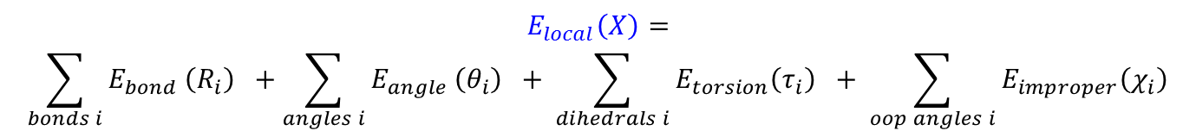

MOLECULAR MECHANICS (MM)
Principle of additivity
The molecular energy can be expressed as a sum of terms derived from simple forces:
* mechanical strains arising from deviations from “ideal” bond lengths and bond
angles, and internal torsion
* van der Waals and electrostatic interactions
The molecular energy as a function of the molecular geometry X can thus be separated
into local (bonded) and nonlocal (nonbonded) terms:
$$E_{local}\left(X\right)=$$
$$\sum_{bonds i}{E_{bond}}\left(R_{i}\right) +\sum_{angles i}{E_{angle}}\left(θ_{i}\right) + \sum_{dihedrals i}{E_{torsion}\left(τ_{i}\right) + \sum_{oop angles i}{E_{improper}\left(χ_{i}\right)}}$$
$$E_{nonlocal}\left(X\right)=$$
$$\sum_{\begin{aligned}&nonbonded \\ &pairs i,j\end{aligned}}{E_{VdW}\left(r_{ij}\right) }+ \sum_{\begin{aligned}&all atom \\ &pairs i,j\end{aligned}}{E_{electrostatic}}\left(r_{ij}\right)$$

Slide 4
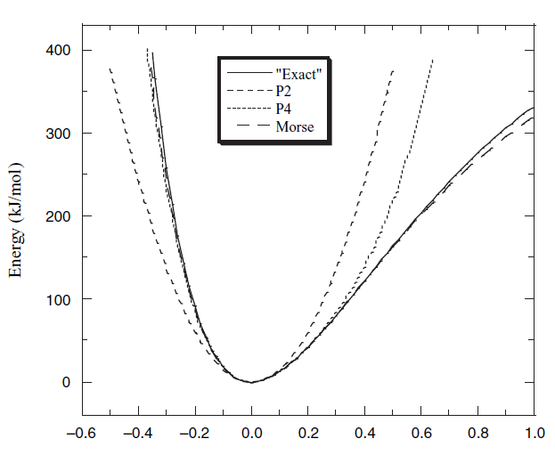
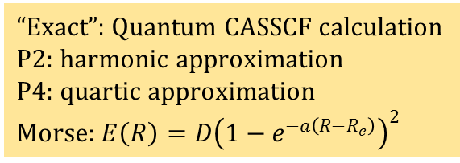
Stretching E_{bond}(R) energy for CH₄
“Exact”: Quantum CASSCF calculation
P2: harmonic approximation
P4: quartic approximation
Morse: $E\left(R\right)=D{\left(1−e^{−a\left(R−R_{e}\right)}\right)}^{2}$
(R – R_{e} )(Å)
F. Jensen, Introduction to Computtional Chemistry, 2nd Edition, Wiley, Chichester, 2007, p. 26

Slide 5
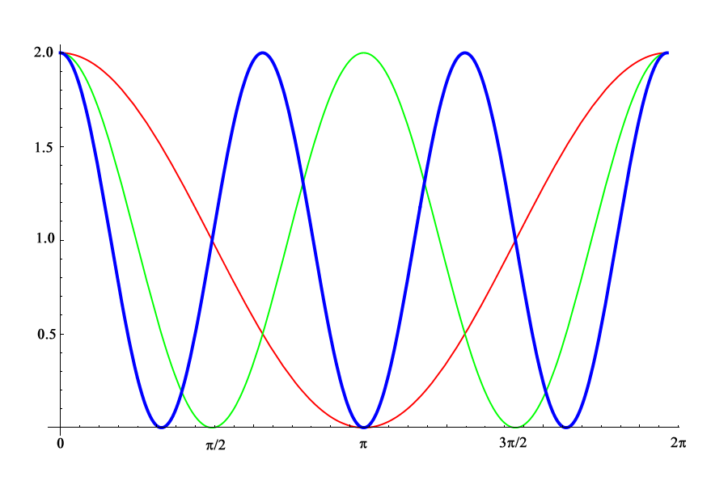
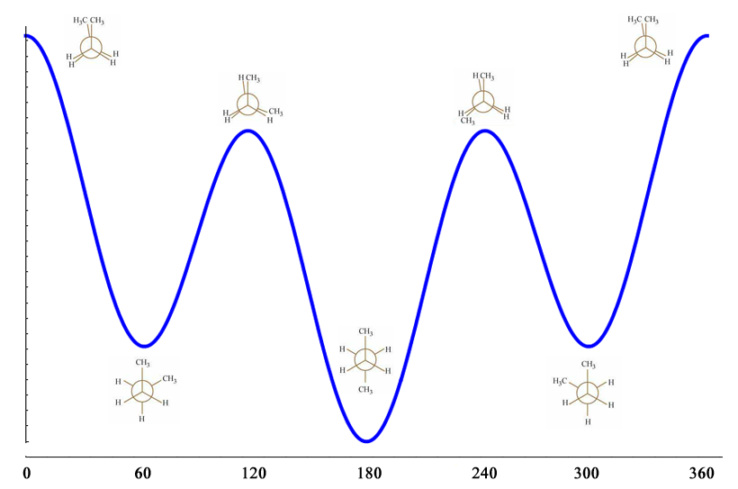
Torsion energy E _{torsion}(τ)
f (τ) = 1 + cos (n τ)
n = 1 , n = 2 , n = 3
τ
$$E_{torsion}\left(τ\right)= \frac{1}{2} V_{1}\left(1+\cos{τ}\right)+ \frac{1}{2}V_{2}\left(1+\cos{2τ}\right)+ \frac{1}{2}V_{3}\left(1+\cos{3τ}\right)$$
V₁ = 0.5
V₂ = -0.2
V₃ = 0.5
τ
LFP

Slide 6
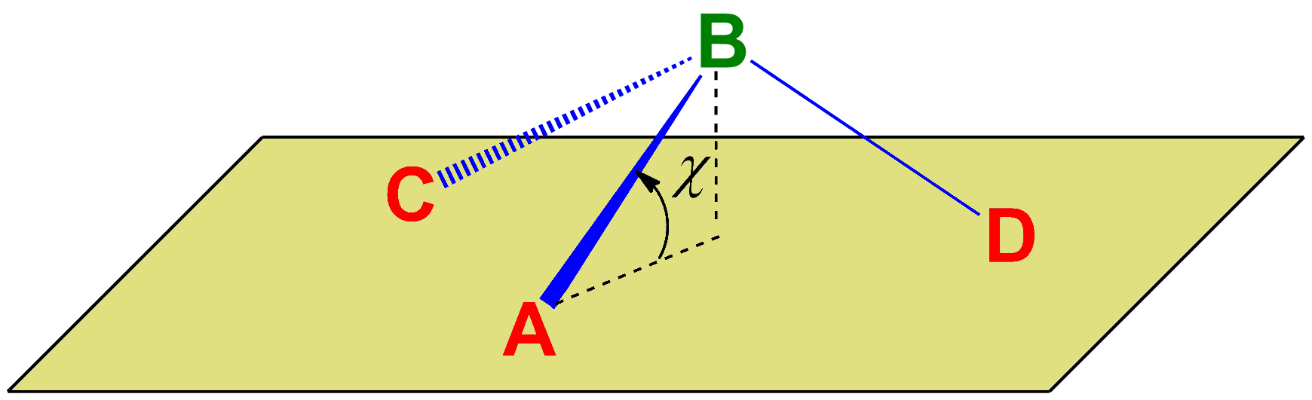
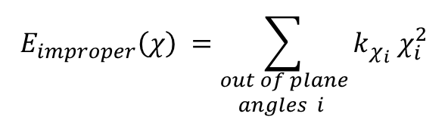
Improper torsion energy E _{improper}(χ)
$$E_{improper}\left(χ\right) =\sum_{\begin{aligned}&out of plane \\ & angles i\end{aligned}}{{k_{χ_{i}} χ}_{i}^{2}}$$
LFP

Slide 7
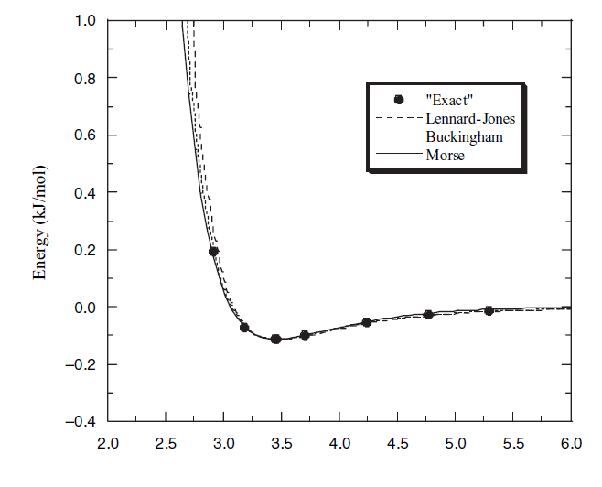
Van der Waals energy for the H₂ …. He interaction
R (Å)
LFP: based on F. Jensen, Introduction to Computtional Chemistry, 2nd Edition, Wiley, Chichester, 2007, p.37

Slide 8
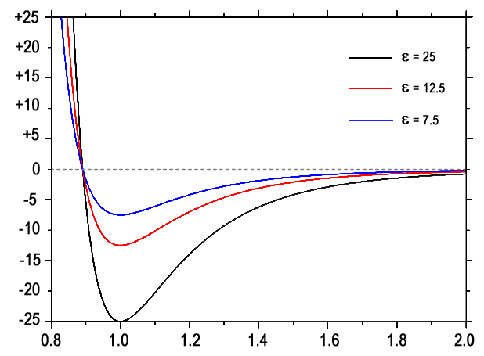
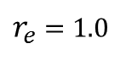
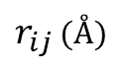
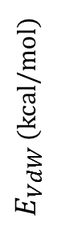
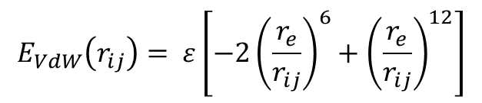
Lennard-Jones Potential (6-12 Potential)
$$E_{VdW}\left(r_{ij}\right)= ε\left[−2{\left(\frac{r_{e}}{r_{ij}}\right)}^{6}+{\left(\frac{r_{e}}{r_{ij}}\right)}^{12}\right]$$
$E_{VdW}$ (kcal/mol)
$r_{e}$ = 1.0
$r_{ij}$ (Å)
LFP: adapted from www.mbnexplorer.com/documentation/3-energy-and-force-calculation/31-pairwise-potentials/314-lennard-jones-potential

Slide 9
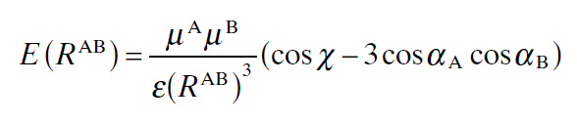
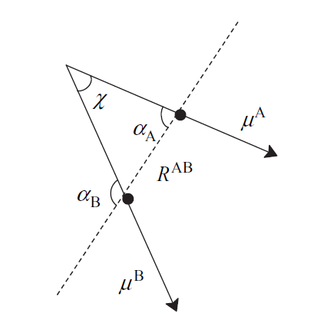
Electrostatic energy
Coulomb interaction between atom pairs: atomic charges
In some force fields, a dipole-dipole interaction term is also included
LFP: adapted from F. Jensen, Introduction to Computtional Chemistry, 2nd Edition, Wiley, Chichester, 2007, p.41

Slide 10
Force Fields
The whole set of parameters is obtained for types of atoms which are defined
within a particular MM model: Force Field
Popular Force Fields:
All types of molecules
UFF Universal Force Field
Dreiding Generic force field
Organic molecules
MM2-MM4 Allinger’s Molecular Mechanics Models 2, 3 & 4
MMFF Merck Molecular Force Field (MMFF94 …)
GAFF General Amber Force Field
MMTK Molecular Mechanics ToolKit (uses Amber94)
Proteins
CHARMM Chemistry at HARvard Molecular Mechanics
AMBER Assisted Model Building with Energy Refinement
GROMOS GROningen MOlecular Simulation

Slide 11
Atom types in force fields
A few examples of atom types defined in CHARMM
Atom Symbol Type
Carbon C polar in peptide backbone
CA aromatic
CC carbonyl (Asn, Gln, Asp, Glu)
CP1,2,3 special tetrahedral in Pro
CPT inter-ring in Trp
CT1 aliphatic sp³ in CH
CT2 aliphatic sp³ in CH₂
CT3 aliphatic sp³ in CH₃
Oxygen O carbonyl
OC carboxylate
OH1 hydroxyl
Nitrogen N proline
NH1 peptide
NH2 amide
Hydrogen H polar
HA nonpolar
HP aromatic
HS thiol
(there are around 160 atom types in CHARMM for proteins)

Slide 12
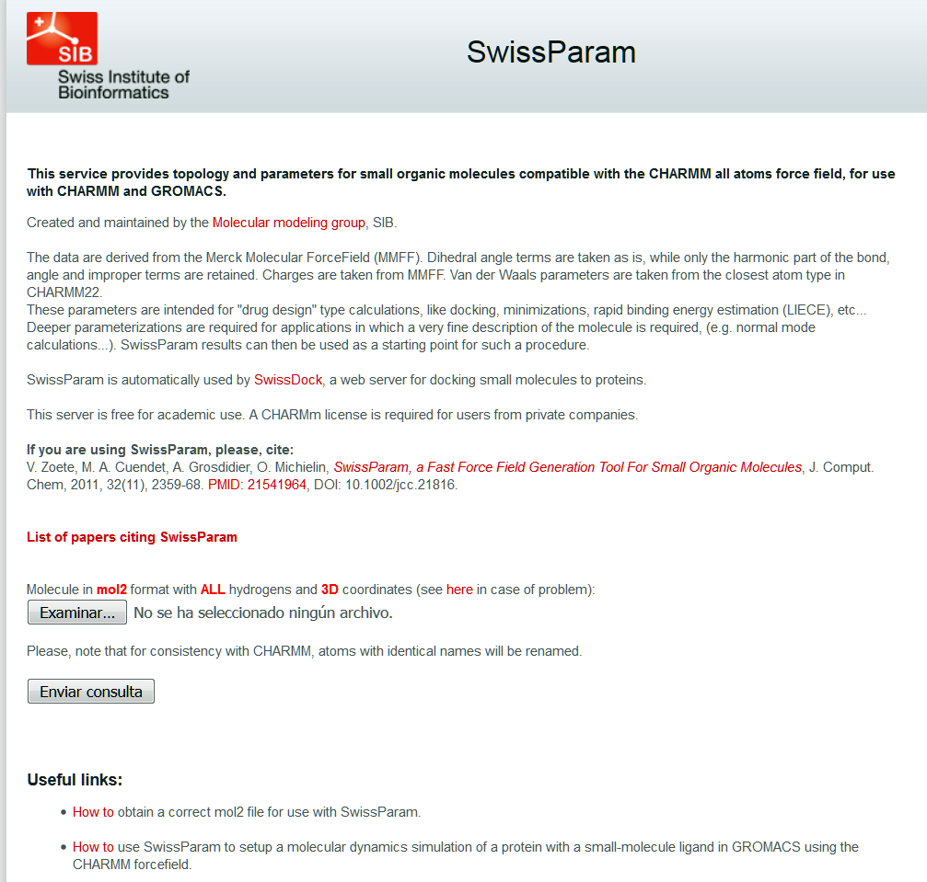
swissparam.ch/

Slide 13
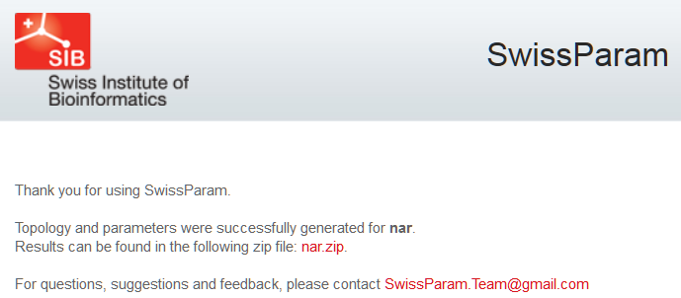
crd: cartesian coordinates (needed for Gromacs)
itp: CHARMM parameters (needed for Gromacs)
mol2: copy of the initial mol2 file with atomic charges computed by SwissParam
par: CHARMM parameters (needed for VMD/NAMD)
pdb: copy of the structure in pdb format
psf: CHARMM protein structure file
rtf: CHARMM residue topology file (needed for VMD/NAMD)

Slide 14
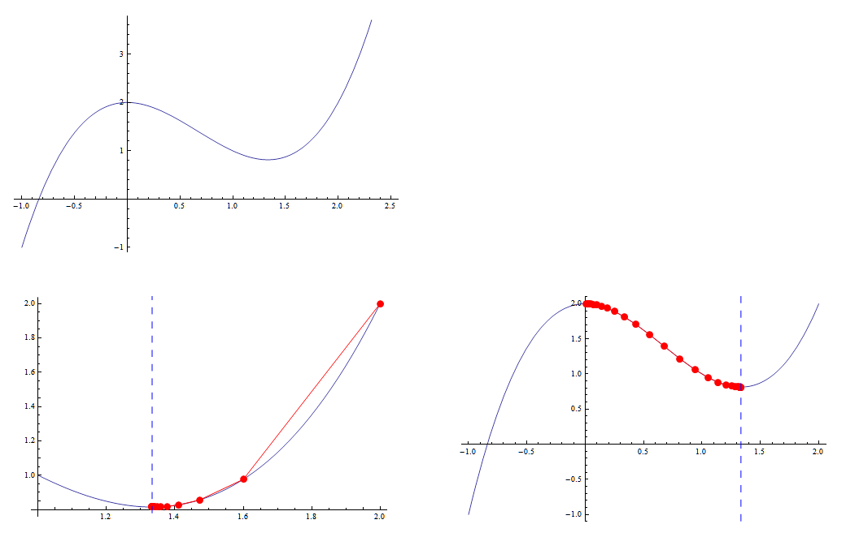
Steepest descent applied to a 1-dimensional function
f(x) = x³ – 2x² +2
λ = 0.1
x
x
x
x₀ = 2 10 steps
x₀ = 0.01 28 steps
LFP

Slide 15
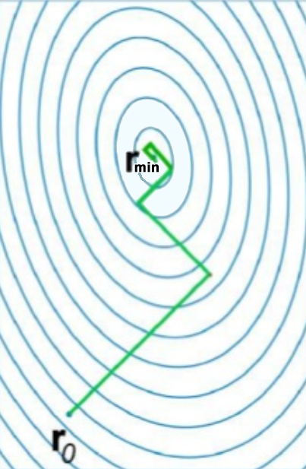
Steepest descent applied to surfaces
Pros: Fast when far from minimum,
local minimization guaranteed
Cons: Slow descent for certain surfaces,
can oscillate near minimum
Improve convergence:
* Reduce λ near minimum
* Determine step size by line search:
from point i calculate the function at several
points along –g, fit a polynomial to calculated
values and find the minimum to get point i+1
Use steepest descent far from minimum and
then switch to another method (conjugate
gradient) when closer to the minimum
LFP: adapted from www.slideshare.net/qchemforqespresso/lecture3-46436717 (slide 14)

Slide 16
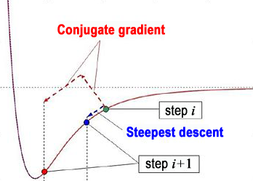
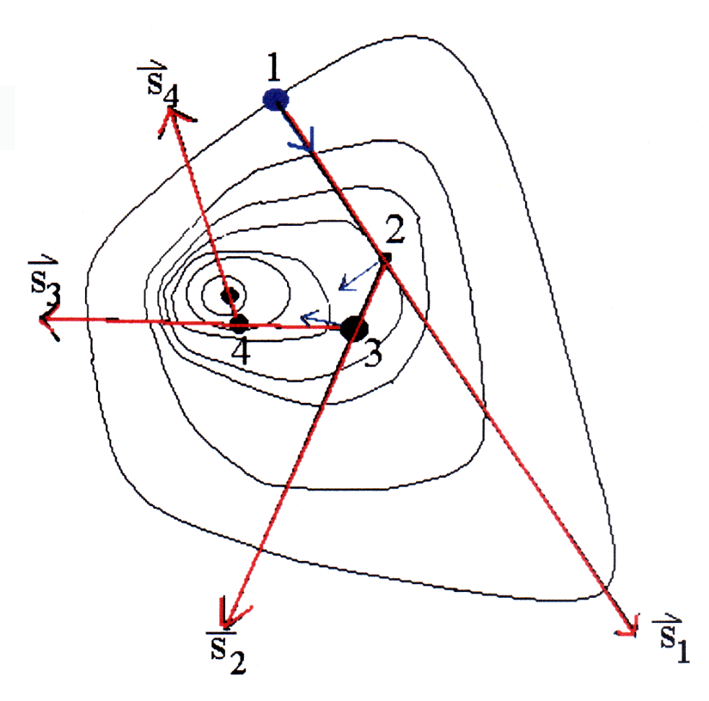
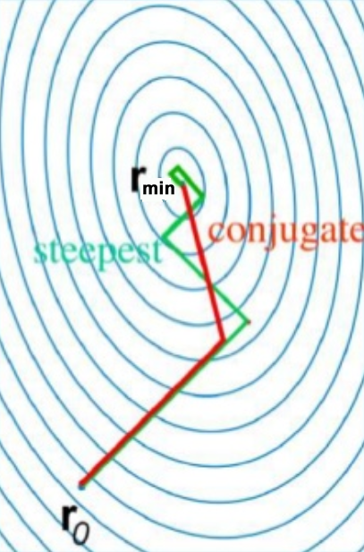
Conjugate gradient
2
1
3
Pros: Using history, much faster convergence
Cons: Greater computational cost
1,2: LFP: adapted from F. Jensen, Introduction to Computational Chemistry, 2nd Edition, Wiley, Chichester, 2007
3: LFP: adapted from www.slideshare.net/qchemforqespresso/lecture3-46436717 (slide 16)

Slide 17
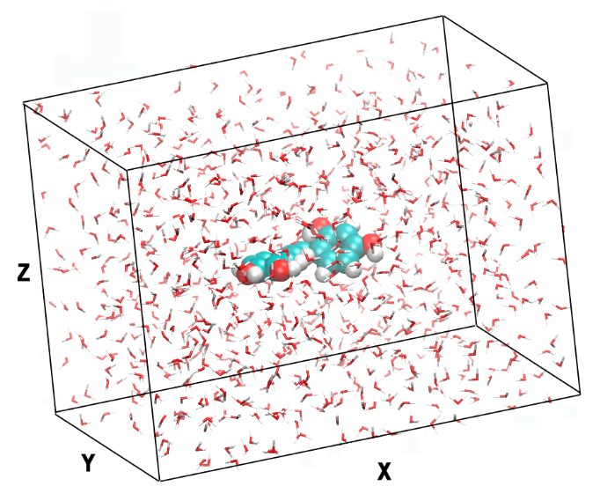
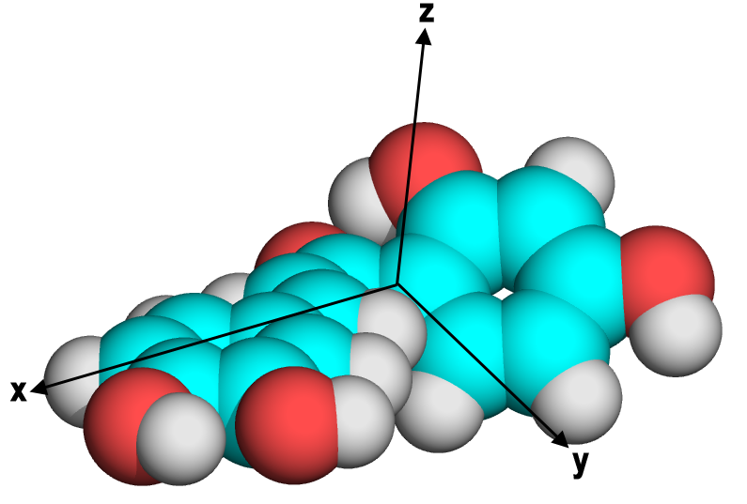
Solvation box
Butein dimensions (Å)
x_{min} = -4.623 , x_{max} = 6.867 Δx = 11.490
y_{min} = -2.909 , y_{max} = 4.307 Δy = 7.216
z_{min} = -1.568 , z_{max} = 1.374 Δz = 2.942
Solvation box (12 Å margin)
35.490 x 31.216 x 26.942
Volume = 29,848 Å³
877 water molecules
LFP

Slide 18
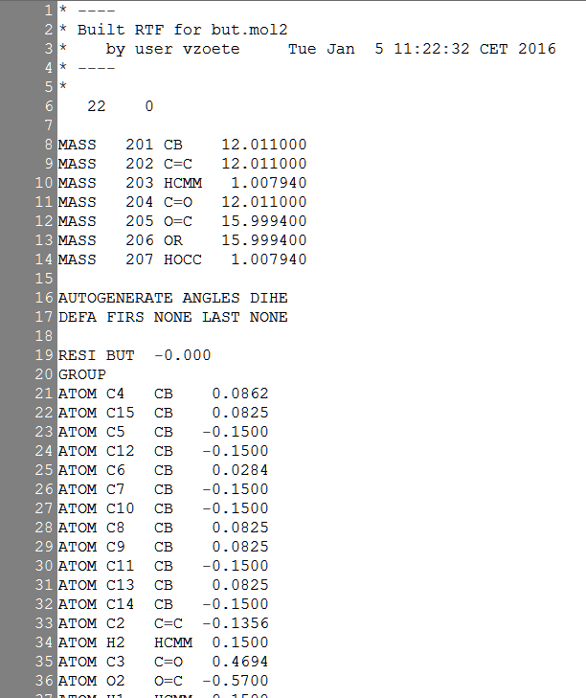
SwissParam data to generate PQR files
Atom radii derived from CHARMM
PQR values in proteins
Carbon
Aromatic 1.9924 (CB)
Double bond 2.0000 (C=)
Single bond 2.1750 (CR)
Oxygen
Carbonyl 1.7000 (O=)
Hydroxyl, ether 1.7700 (OR)
Nitrogen
Unique value 1.8500 (N?)
Hydrogen
Bonded to O or N 0.2245 (HO, HN)
Bonded to C 1.3500 (HC)
Total charge
Atom Atomic
types charges

Slide 19
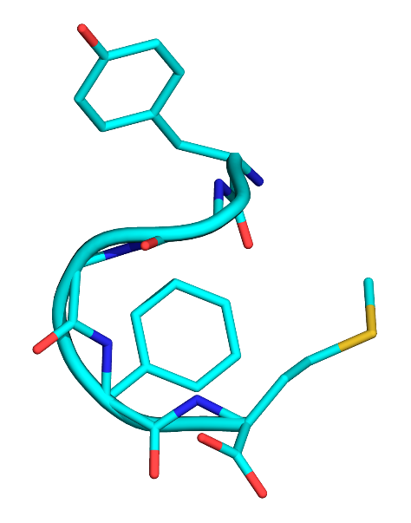
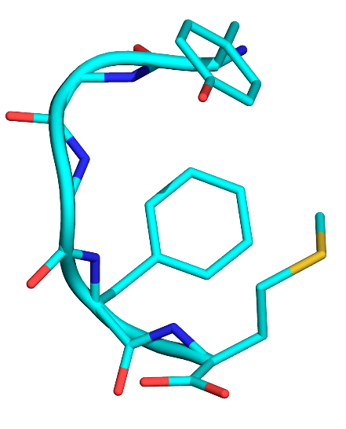
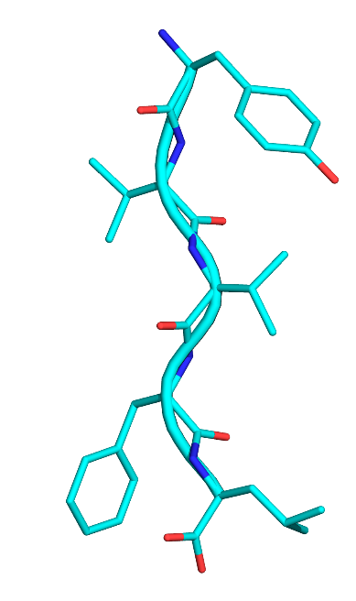
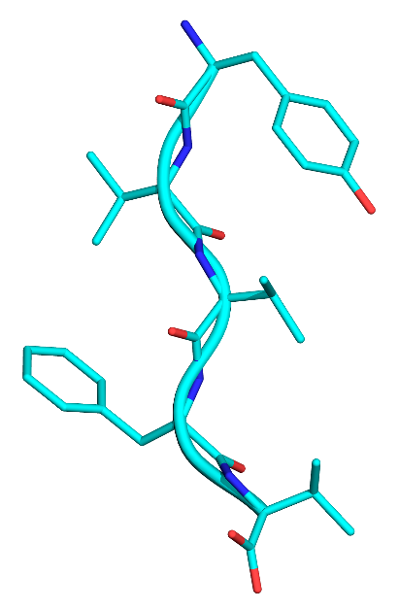
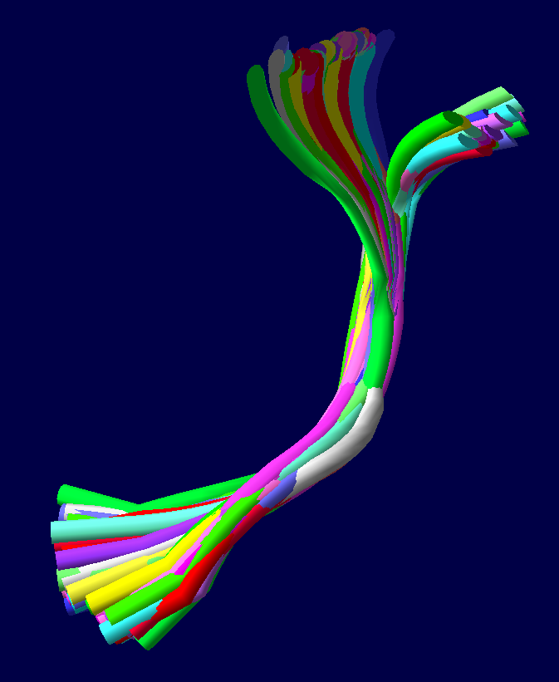
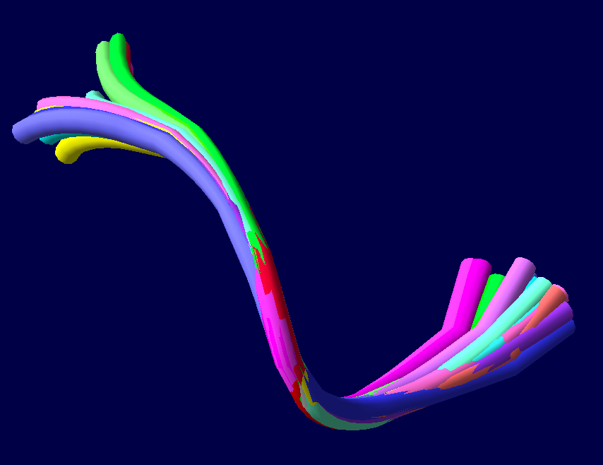
Met-enkephalin Leu-enkephalin
1PLX
NMR
TGGFM
2LWC
NMR
TGGFM
4OLR
X-ray
TVVFV
(mutant)
4ONK
X-ray
TVVFL
2LWC NMR
20 conformations
1PLX NMR
80 conformations
LFP

Slide 20
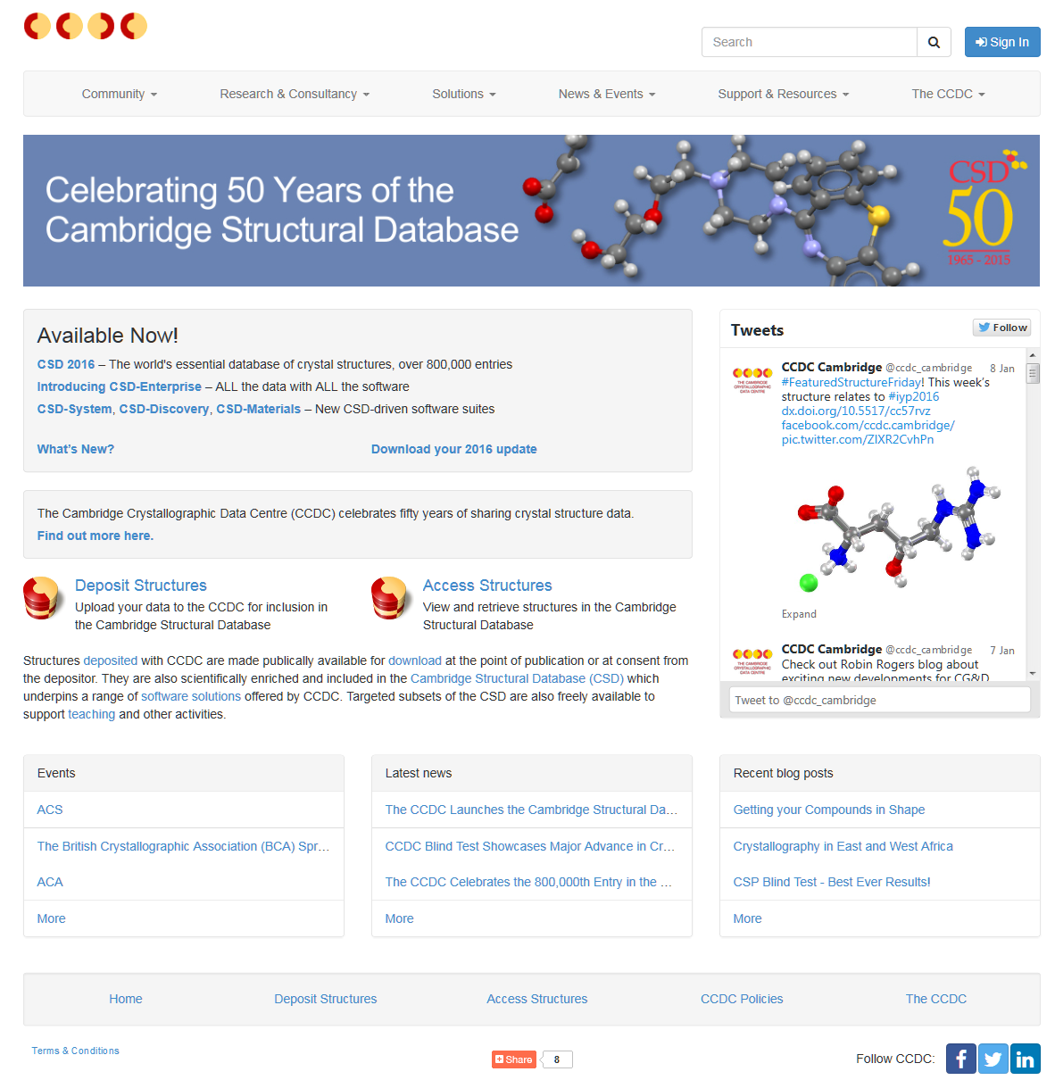
www.ccdc.cam.ac.uk

Slide 21
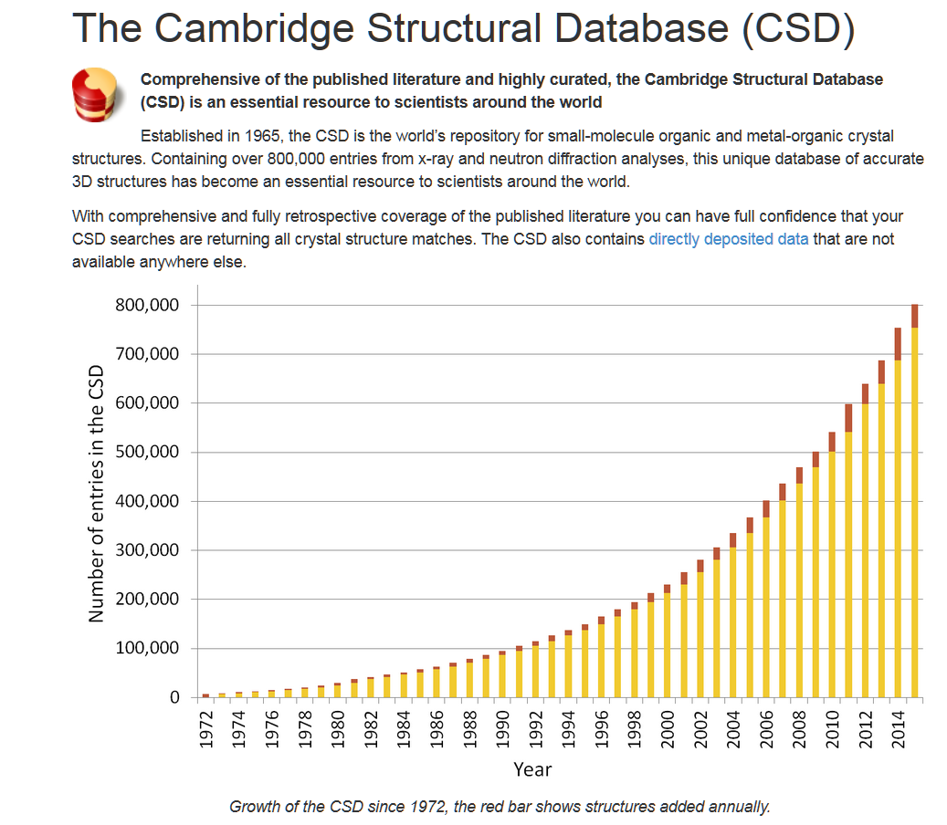

Slide 22


Slide 23

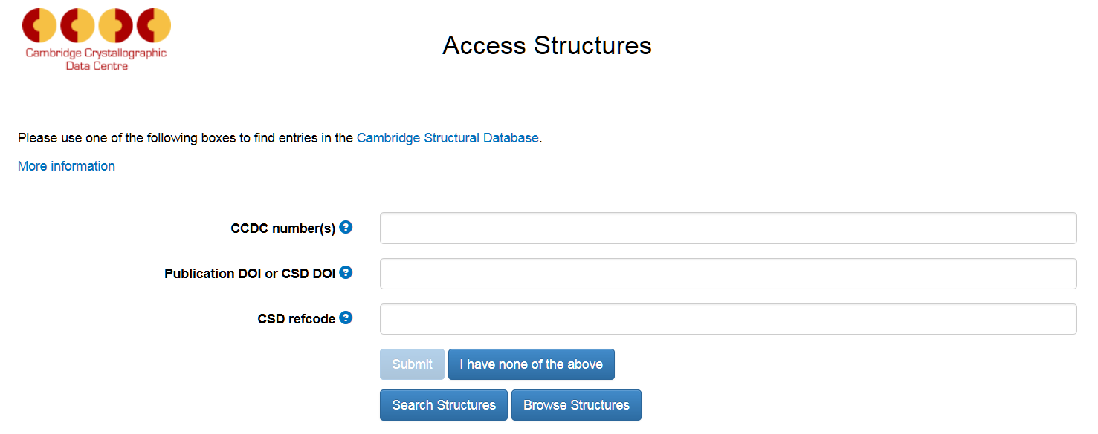
1
free.clipartof.com

Slide 24


Slide 25
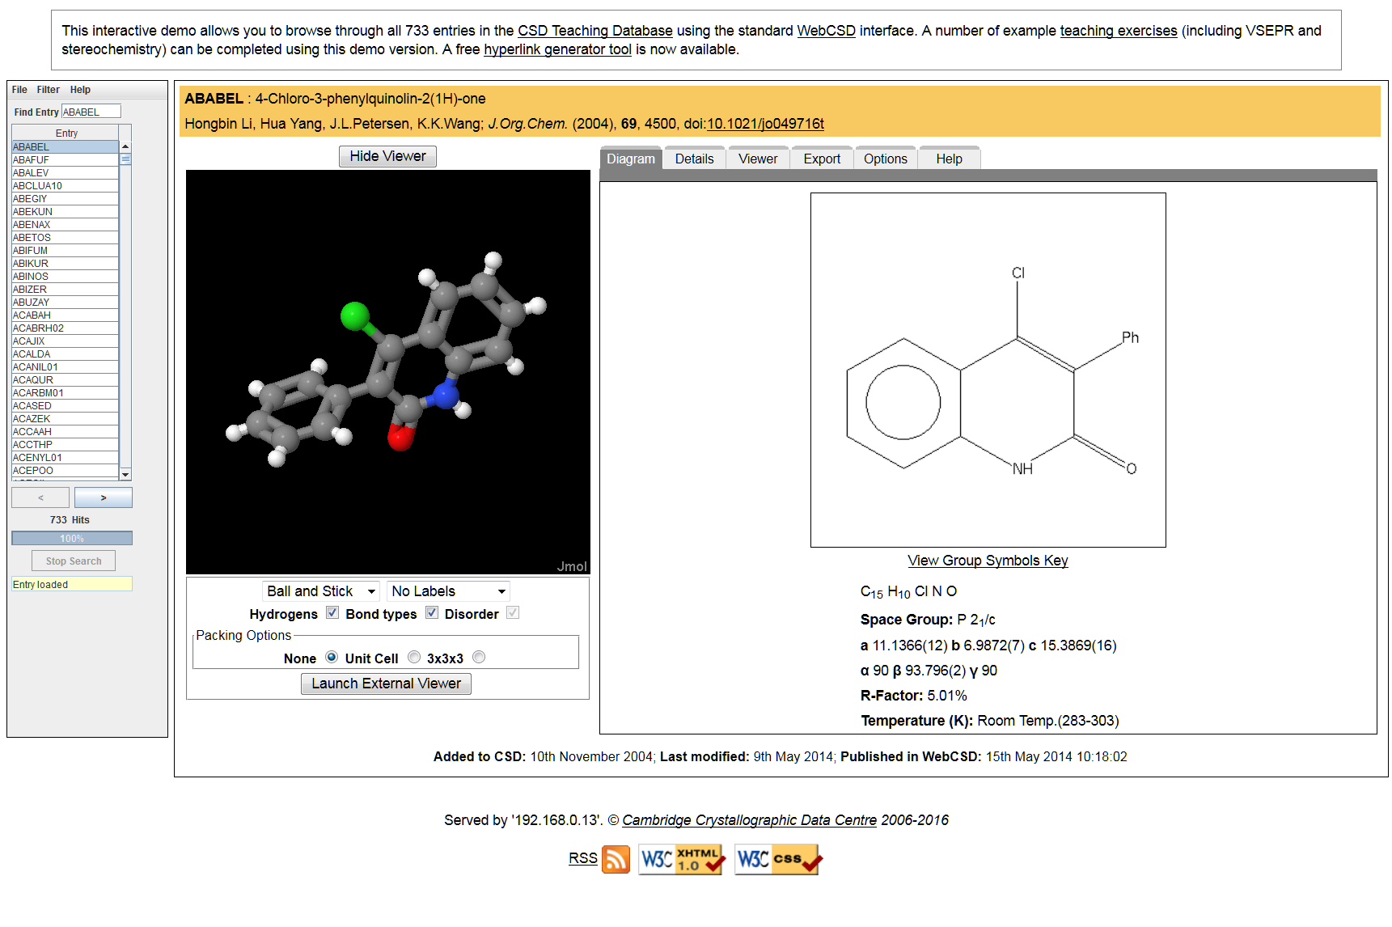

Slide 26
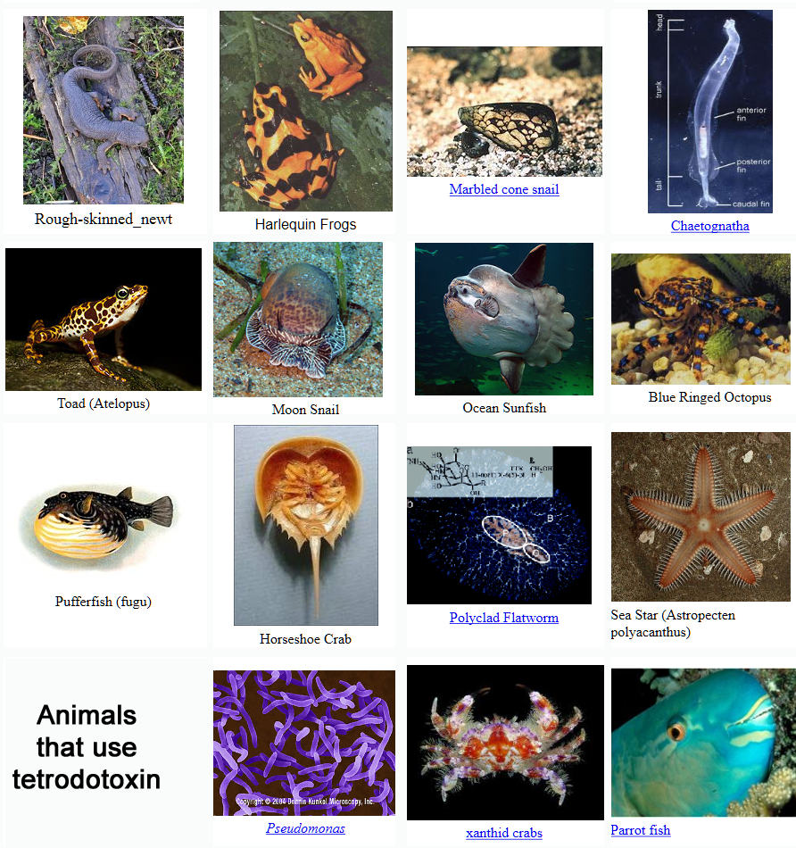
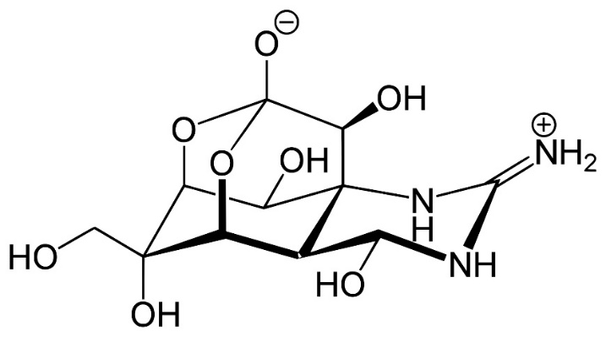
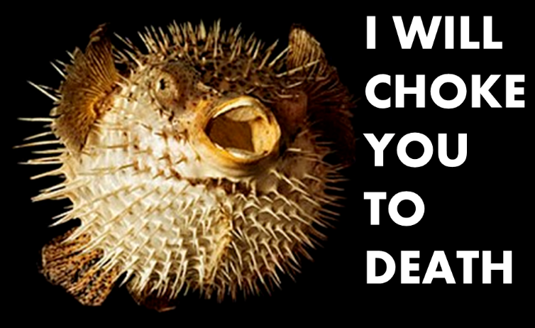
Tetrodotoxin
3
1
2
1: commons.wikimedia.org/wiki/File:Tetrodotoxin.svg
2: badassbiology.wordpress.com/2014/06/16/tetrodotoxin/
3: yukna.free.fr/science/biology/poisonous/Tetrodotoxin/TetrodotoxinWebquest.php

Slide 27
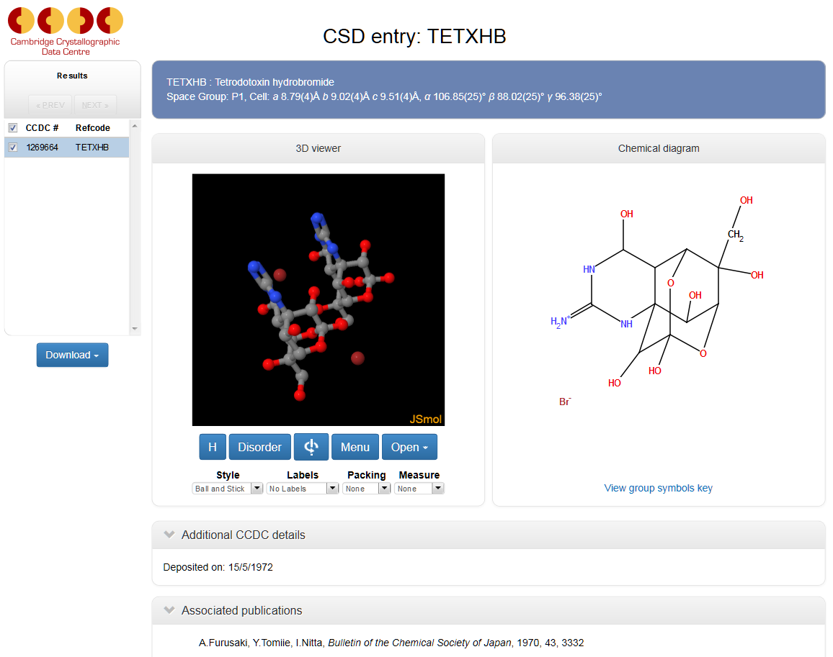
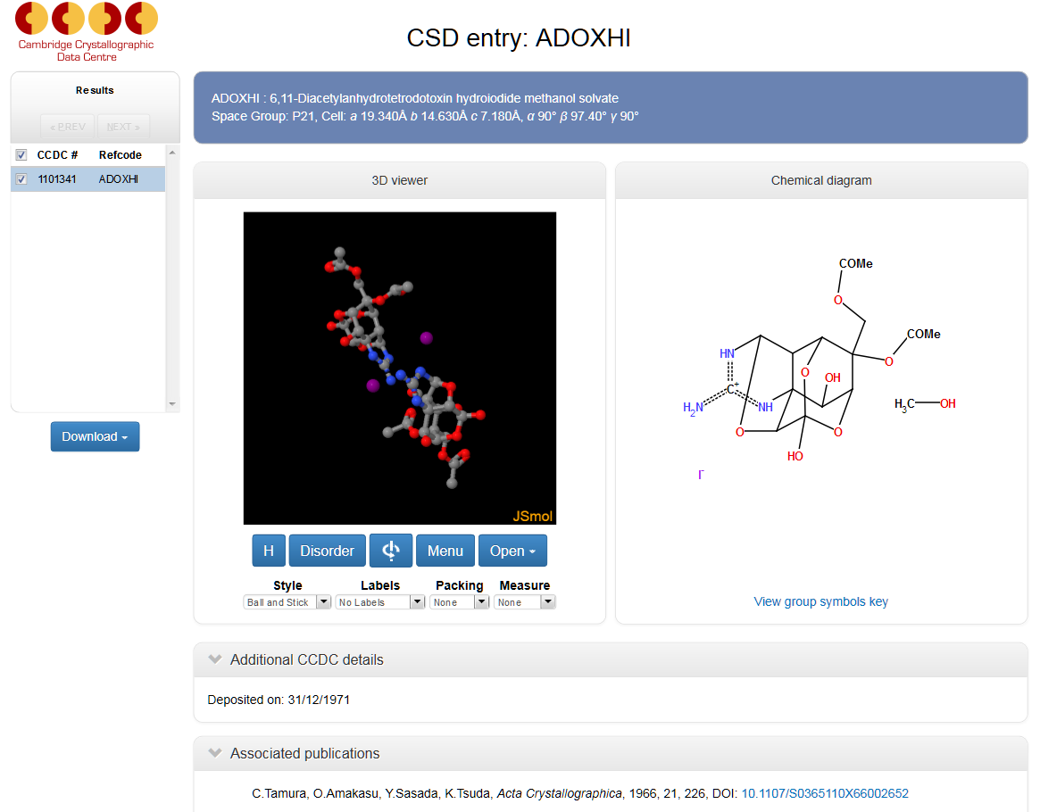
Tetrodotoxin CSD entries
TETXHB
Tetrodotoxin hydrobromide
ADOXHI
6,11-Diacetylanhydrotetrodotoxin hydroiodide methanol solvate

Slide 28
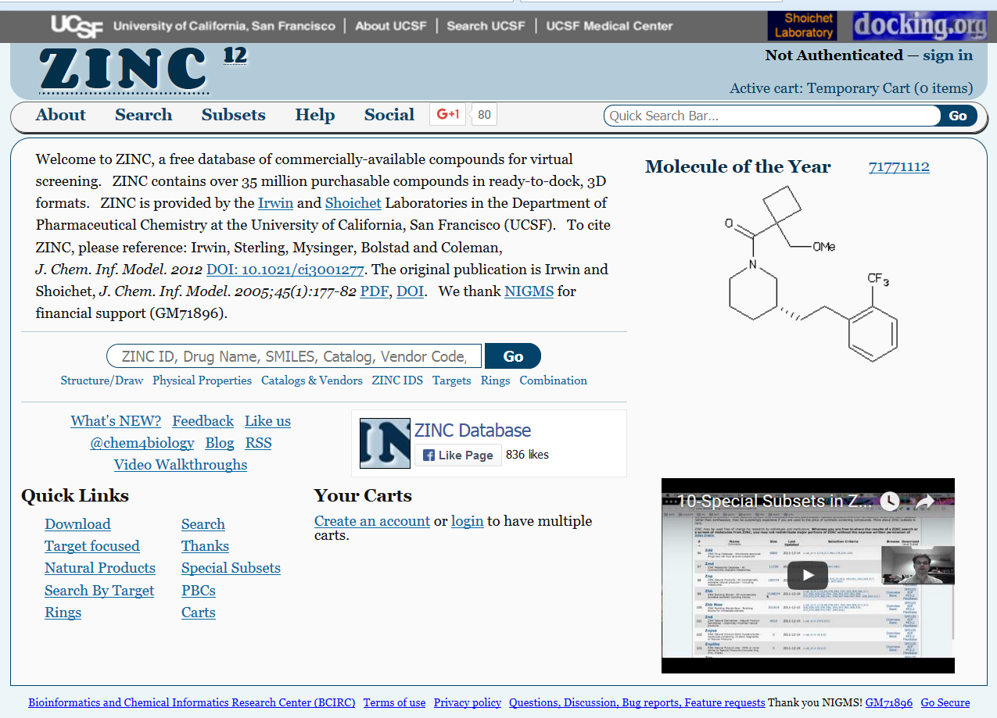
zinc.docking.org/

Slide 29
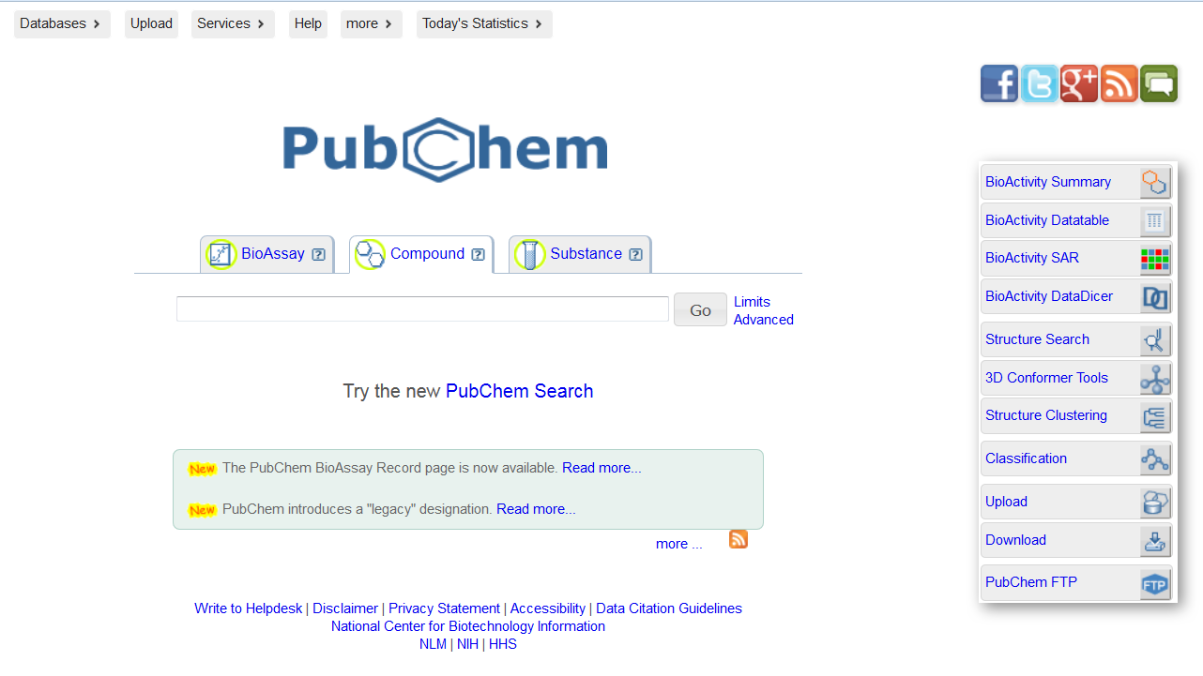
pubchem.ncbi.nlm.nih.gov/

Slide 30
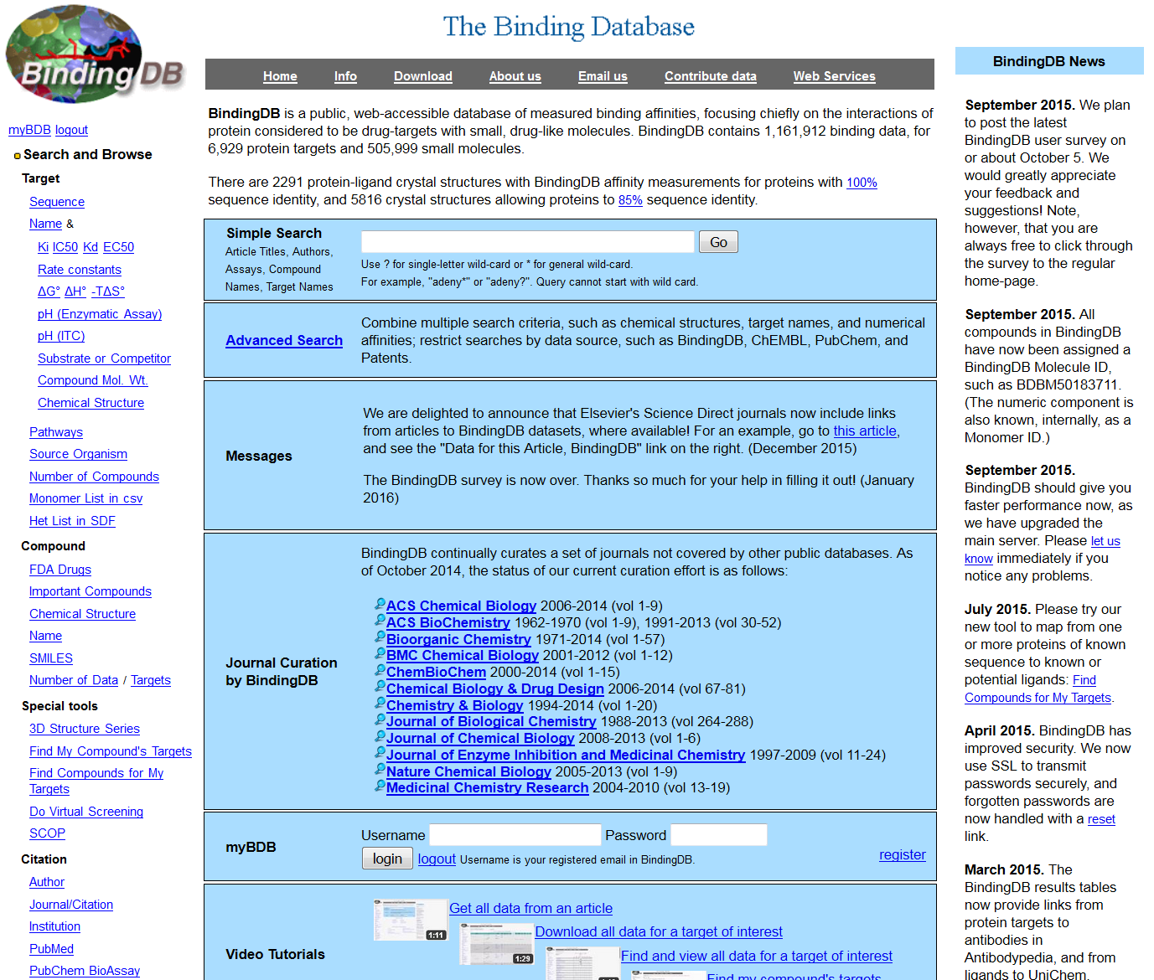
www.bindingdb.org/bind/index.jsp

Slide 31
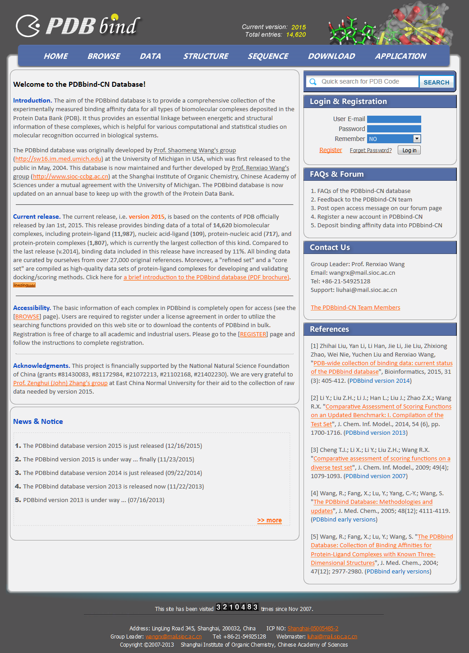
www.pdbbind.org.cn/

Slide 32
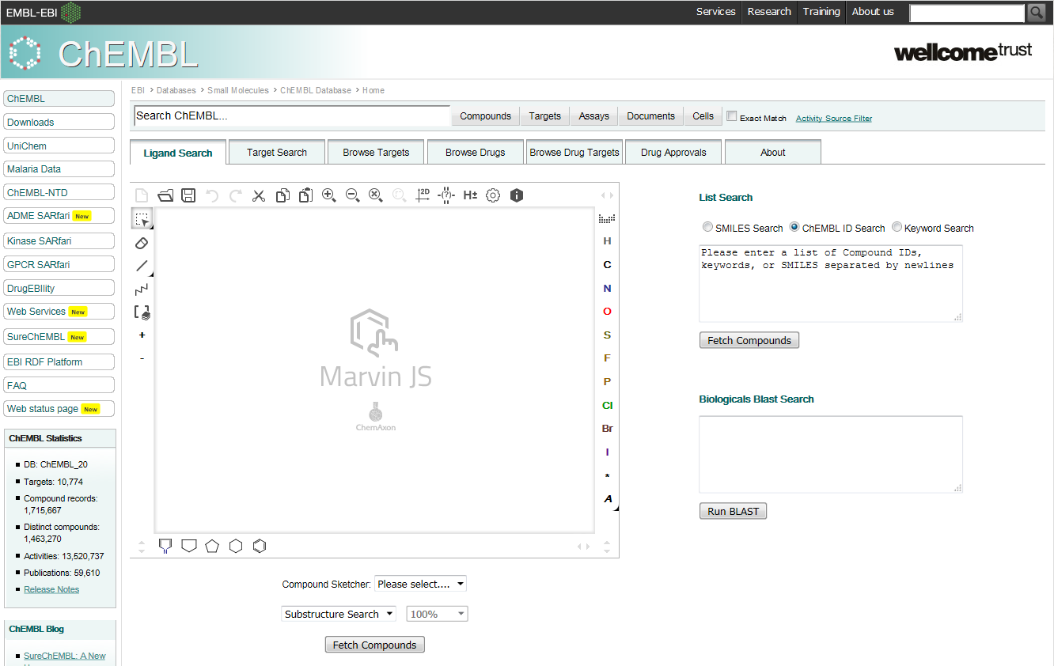
www.ebi.ac.uk/chembl/

Slide 33
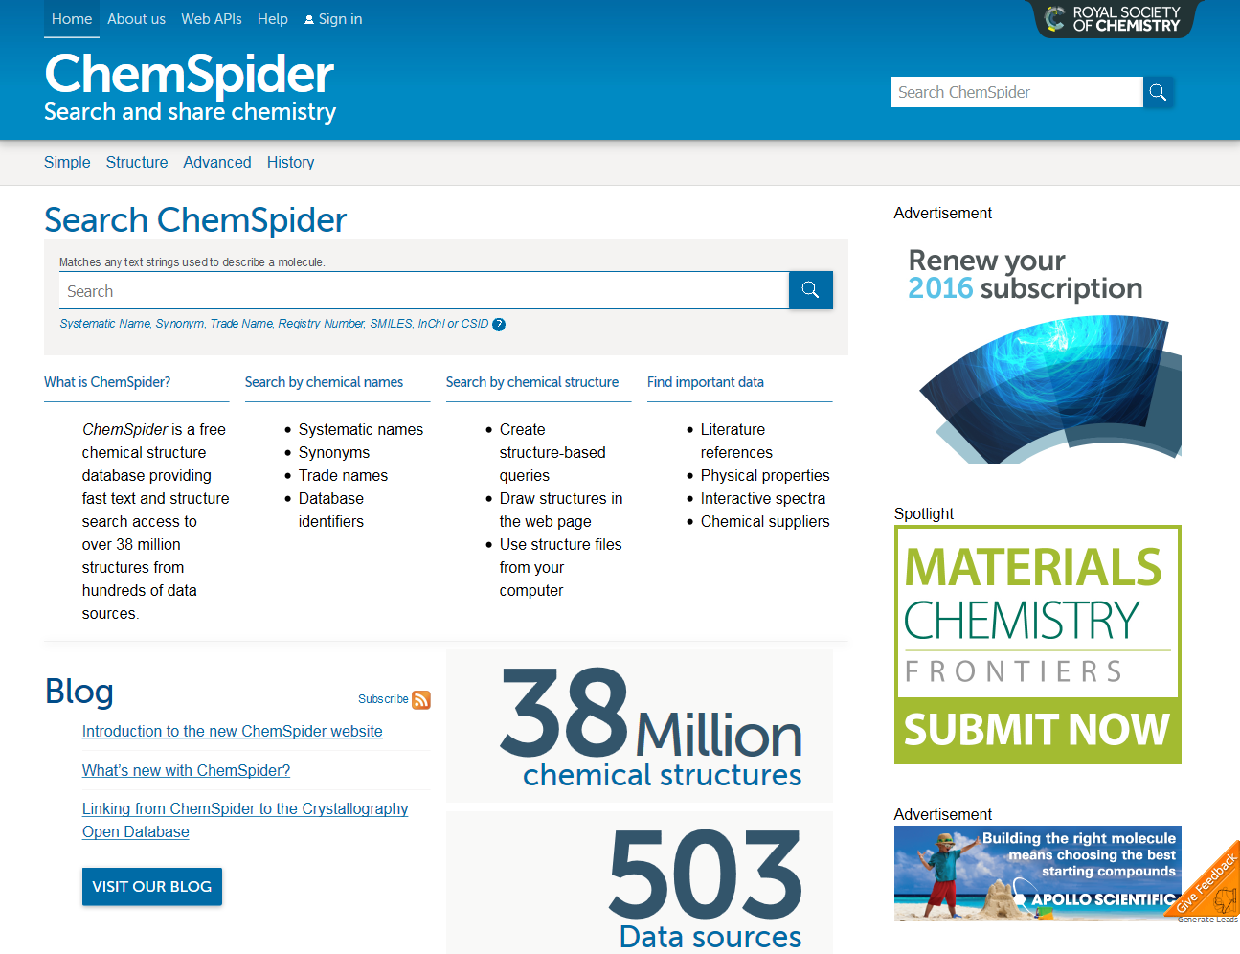
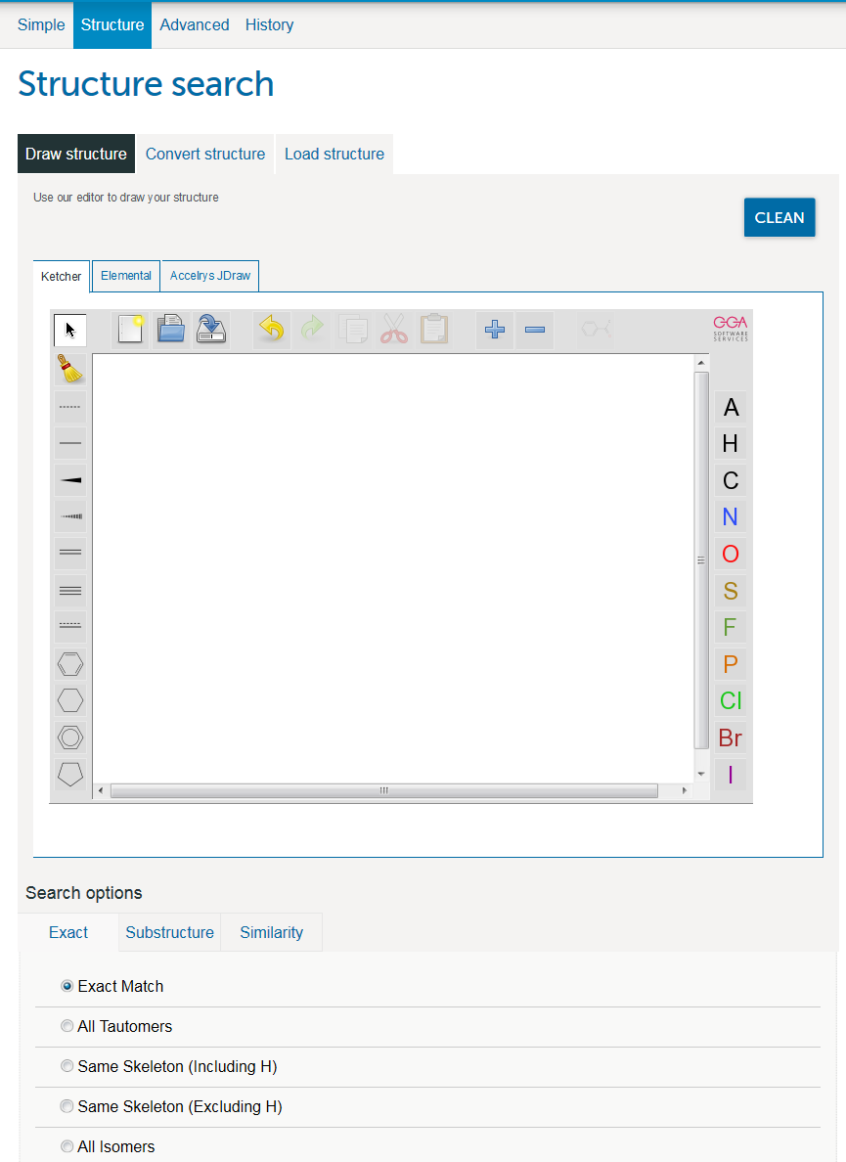
www.chemspider.com/

Slide 34
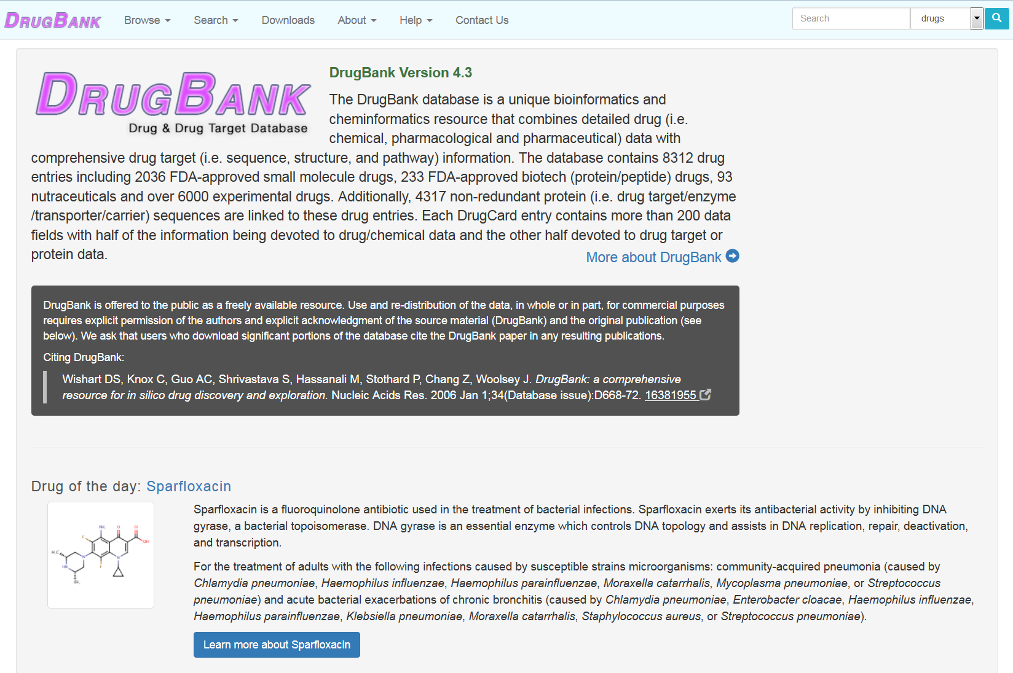
www.drugbank.ca/

Slide 35
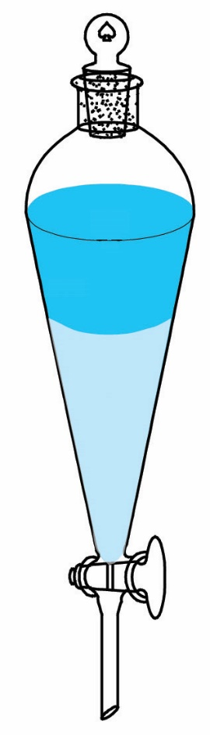
Octanol-water partition coefficient P_{ow} (P)
(1)
A compound X accumulates in fat tissues if it is more soluble in fats than
in water: lipophilic
The solubility of organic compounds in fats is very similar to their solubility in
octanol (n-octanol: CH₃-(CH₂)₆-CH₂OH). A reliable approximation to the relative
solubility in fats and water is the octanol-water partition coefficient P. This is
usually taken as a descriptor of the lipophilicity of a compound
Toxic organic compounds have usually large P about 10³ -10⁷. As a matter of
convenience, values of P are used as decimal logarithms log P
The higher its P, the more likely a compound is to be bound to organic matter
in soils and sediments and ultimately to migrate to fat tissues of living organisms.
Compounds with log P ~ 4 - 7 accumulate in living tissues to a great extent.
Organochlorine pesticides have log P between 4 and 6. Carbamates contain N
atoms, organophosphorate insecticides have O and S atoms: these molecules are thus able to form H-bonds with water, their log P is between 1 and 3.7 and they accumulate in living tissues far less than chlorinated organic compounds
However, log P > 7 are indicative of chemicals with such strong adsorption to sediments that they
are not mobile enough to enter living tissues and their accumulation in living organisms is very low
(o)
(w)
1: chemwiki.ucdavis.edu/Analytical_Chemistry/

Slide 36
Octanol-water partition coefficient P
DDT Methoxychlor
log P = 6.91 5.33
Substituting methoxy groups for Cl atoms in DDT renders a more water-soluble compound
because O atoms are able to make H-bonds with water molecules. Methoxychlor is more biodegradable and presents less bioaccumulation problems than those associated with DDT
It can be said that DDT is more lipophilic than metoxychlor by a factor of
10^{(6.91 – 5.33)} = 10^{1.58} = 38

Slide 37
Experimental log P data
Acetamide −1.16
Methanol −0.82
Formic acid −0.41
Diethylether 0.83
p-Dichlorobenzene 3.37
Hexamethylbenzene 4.61
2,2’,4,4’,5-Pentachlorobiphenyl 6.41
hydrophilic
lipophilic
(hydrophobic)

